Slide 1
FMCG Industry Overview
SEP 2025
Confidential

Slide 2
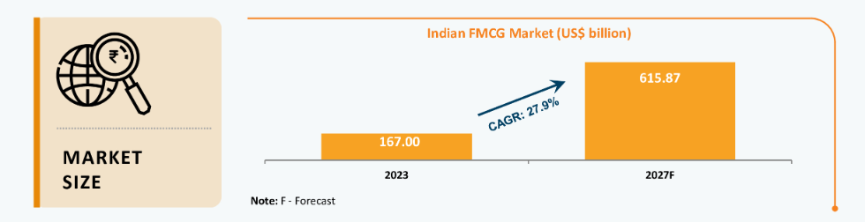





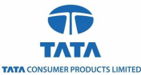




FMCG Industry in India
Overview
Market Size (US$B)
The FMCG sector in India expanded due to consumer-driven growth and higher product prices, especially for essential goods.
FMCG market reached Rs. 14,50,896 crore (US$ 167 billion) as of 2023. The total revenue of the FMCG market is expected to grow at a CAGR of 27.9% from 2021-27, reaching nearly Rs. 53,43,120 crore (US$ 615.87 billion).
In Q4 FY25, rural markets continued to outperform urban markets in the Fast-Moving Consumer Goods (FMCG) sector, with leading players such as Dabur, Marico, and AWL Agri Business (formerly Adani Wilmar) highlighting stronger rural demand, particularly in food categories
Major Players
Investment and policy support
  ITC
  Hindustan Unilever Limited
  Amul
  Nestle India
  Britannia Industries
  Godrej Consumer Products
  Marico Limited
  Tata Consumer Products
  Dabur India
  Varun Beverages
The Union Budget 2025-26 provides a strong push to consumer spending, particularly benefiting the FMCG industry. The increase in disposable income, rural development focus, and MSME support create an ideal environment for growth.
Amul will set up the world's largest curd plant in Kolkata, West Bengal, with an investment of Rs. 600 crore (US$ 68.6 million), processing 10 lakh kilograms (KG) daily.
Source: IBEF, India Briefing, Web search

Slide 3
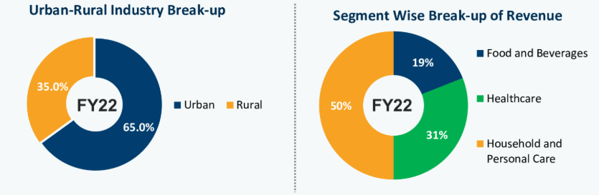
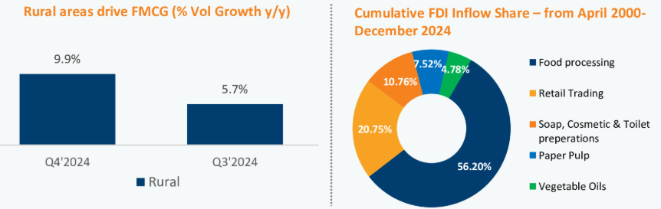
FMCG Industry in India (Cont’d)
Key Drivers
Market Segments
Shift to Organised Market: Consumers in India’s metro cities are increasingly opting for supermarket chains and online grocery shopping, which helps companies generate more revenue.
Rural Consumption: Due to low penetration levels and rising disposable income in rural India, FMCG companies have enormous growth potential in this sector.
Easy Access: The accessibility of e-commerce across the country, whether in rural or metropolitan areas, has resulted in a noticeable shift in demand.
Recent Activities / News
Key Trends in FMCG
Sep 25 : The GST reforms will reduce rates on essential FMCG products.
July 2025 : FMCG makers see impact of erratic weather on topline growth in Q1FY26
Jun 2025:FMCG companies see muted Q4 performance amid weak urban demand; rural recovery offers some relief. (source : ET)
Source: India Briefing, Web search

Slide 4
FMCG SWOT Analysis
Strength
Weakness
Robust Market Growth: The Indian FMCG market has demonstrated significant expansion, with projections indicating a compound annual growth rate (CAGR) of 27.9%, reaching approximately USD 615.87 billion by 2027.
Diverse Product Portfolio: The sector encompasses a wide array of products, including food and beverages, personal care, and household items, catering to the varied preferences of a vast consumer base.
Strong Distribution Networks: Established supply chains facilitate extensive reach across urban and rural markets, ensuring product availability and fostering consumer trust.
Inflationary Pressures: Persistent inflation, particularly in food prices, has constrained consumer spending, notably among the middle class, leading to a slowdown in urban consumption growth.
Regulatory Challenges: The industry faces complex regulatory environments, including compliance with diverse state and central policies, which can impede operational efficiency.
Dependence on Rural Demand: While rural markets offer growth potential, reliance on these areas exposes companies to vulnerabilities related to agricultural performance and monsoon variability.,
Opportunity
Threats
  Digital Transformation: The rise of e-commerce is reshaping the FMCG landscape, with online sales projected to constitute 15% of total FMCG sales by 2025, up from 8% in 2023.
  Rural Market Expansion: Government initiatives and infrastructural developments are enhancing rural purchasing power, presenting avenues for market penetration and growth.
  Product Innovation and Premiumization: Evolving consumer preferences towards health and wellness products offer opportunities for companies to diversify offerings and tap into premium segments.
  Economic Uncertainties: Stagnant wages and employment challenges can dampen consumer spending, affecting overall demand in the FMCG sector.
  Supply Chain Disruptions: Global events, such as pandemics or geopolitical tensions, can disrupt supply chains, leading to inventory shortages and increased operational costs.
  Shifting Consumer Preferences: A growing inclination towards local or unbranded products, driven by price sensitivity or nationalist sentiments, can impact the market share of established FMCG brands.

Slide 5
Competitive Benchmarking / Landscape – Financials / Valuation
 | HUL | ITC | Tata consumer products | Marico Limited | Nestle India Ltd. | Britannia Industries Ltd.
Ent Value | 6,02,554.38 Cr. | 5,13,261.40 Cr. | 1,07,482.33 Cr. | 95,259.91 Cr. | 2,34,762.63 Cr. | 1,53,349.30 Cr.
M Cap | 6,07,134.38 Cr | 5,18,102.78 Cr. | 1,09,096.45 Cr. | 95,540.91 Cr. | 2,34,762.63 Cr. | 1,50,566.77 Cr.
Profitability
Gross Margins | 49.51% | 32.30% | 15.16% | 21.66% | 23.81% | 19.02%
Net Margin | 16.91% | 46.12% | 7.83% | 15.30% | 23.81% | 12.19%
Return on Equity | 21.55% | 49.61% | 6.39% | 40.99% | 79.98% | 50.01%
RoCE | 22.91% | 38.30% | 7.92% | 36.90% | 57.17% | 59.40%
Valuation
EV/ Sales | 8.29 | 6.76 | 5.57 | 7.72 | 10.78 | 6.68
EV / EBITDA | 37.93 | 17.73 | 41.38 | 39.64 | 49.40 | 44.26
P/E | 56.24 | 14.85 | 82.51 | 57.24 | 75.55 | 68.63
Source: Yahoo Finance, Filings
CONFIDENTIAL - DO NOT DISSEMINATE. This business plan contains confidential, trade-secret information and is shared only with the understanding that you will not share its contents or ideas with
third parties without the express written consent of the plan author

Slide 6
Sub-Sector Analysis
Sub-Sector | Market Data | Demand Trends | Supply Trends
Household & Personal Care | Market Share: 50% Revenue CAGR (10yr): 7% | 1. Growing demand for budget-friendly options: -Nearly 45% of urban consumers are opting for more affordable brands 2. Premiumisation & conscious buying: - Consumers are willing to pay more for eco-friendly, pet-safe, antibacterial, and biodegradable home care products. | 1. Smaller packs catering to rural consumers: - Brands are offering low-cost, smaller packs (like ~`₹10 sachets for cleaners) to make products more affordable and build brand loyalty. 2. Premiumisation in skincare & home care: - Premium skincare is growing at 12% CAGR, with a focus on anti-aging, hydration, and skin-brightening products.
Food & Beverages | Market Share: 31% Revenue CAGR (10yr): 11% | Health-conscious consumers: - 78% of shoppers are willing to pay more for healthier snacks/beverages. - 63% prefer natural products, while 55% opt for organic products | 1. Private label expansion: - Private-label food products are 25-40% cheaper than branded items. 2. Local brands winning consumer trust: - 45% of Indian consumers prefer local F&B brands.
Healthcare | Market Share: 19% Revenue CAGR (10yr): 12% | 1. Growing trust in Ayurveda & Natural Health: - 36% of Indians believe in Ayurvedic health benefits. 2. Rise of digital & self-diagnosis health trends: - 71% of households used nutraceuticals in the past year; 69% without a doctor’s recommendation. | 1. AI & personalized healthcare growth: - Direct-to-Customer (D2C) brands are offering at-home consultations for skincare, stress, and gut health. - GenAI health coaches are providing personalized recommendations, making digital healthcare more accessible. 2. Government push for transparency & AYUSH growth: -The government is also promoting traditional medicine, increasing the AYUSH budget by 23.7%, with 46% of rural and 53% of urban consumers embracing Ayurveda
Source: Web search
CONFIDENTIAL - DO NOT DISSEMINATE. This business plan contains confidential, trade-secret information and is shared only with the understanding that you will not share its contents or ideas with
third parties without the express written consent of the plan author

Slide 7
Thank You !

